Slide 1
Dead-Air Detector
For streaming radio stations
Dave LeVasseur 25-Feb-2022

Slide 2
My streaming radio station, K-Dave has been operational for quite a few years.
Over that time I have found that something in the audio chain stops for various reasons such as my MP3 player runs out or the audio processing software quits processing audio.
If I’m not actively monitoring the stream I may not notice the “Dead Air” for several hours. So I decided I needed to quickly create a system that would notify me if audio stopped for more than a few minutes.
If you need a system that will provide notification in less than about five minutes’ time this method may not work or will require modification.

Slide 3
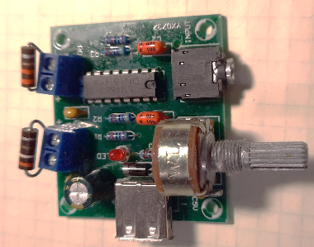
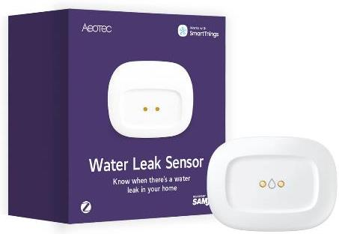
The setup consists of an audio amplifier using two resistors as “loads” in place of the speakers and a temperature/leak detector. The audio amplifier heats up the resistors as long as audio is present. The temperature detector senses the heat from the resistors and sends a text when its temperature drops below a given set point if the audio has stopped.
Aeotec SmartThings Temperature / Water Leak Sensor, ZigBee, Battery Powered, Smart Home Hub Compatible Available from Amazon and elsewhere between $14 and $36. SAVE THE BOX IT CAME IN. We’ll be using it later.
If you don’t already have one you will also need an Aeotec or SmartThings hub to manage the sensor ($125)
Audio Amplifier Board, PM2038 USB Amplifier Audio Module Power Audio 5W DC 2V-6V for Sound System Speaker DIY Available from Amazon for $6.99 as of February, 2022 (cheaper elsewhere)

Slide 4
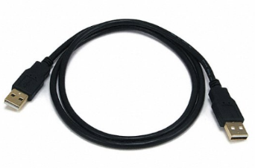
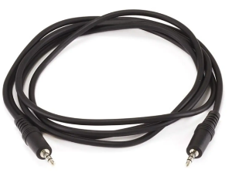
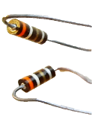
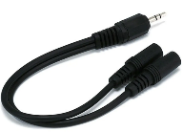
In addition to the amplifier, the temperature sensor and a hub you’ll need a USB-A to USB-A cable, an audio cable and two ¼W resistors of around 4Ω each.
USB-A to USB-A cable. Available various places such as monoprice for around $3. It will be used only for power so cheap is fine. This will be used to power the amplifier so buy one long enough to allow you to place the finished sensor, amplifier and box in a suitable location (details later).
1/8” (3.5mm) stereo audio cable. Available various places such as Monoprice for around $2. Choose length as your needs dictate.
Two ¼W resistors. Shown here are two 3.9Ω (ORG-WHT-GOLD) but I ended up using a 3.3Ω (ORG-ORG-GOLD) and a 3.9Ω based on what I had in my junk box. I would have preferred two 3.3Ω but had only one.
If your audio is available from a 1/8” (3.5mm) audio jack you may need a “Y” splitter to patch in the Dead Air monitor to your audio chain.

Slide 5
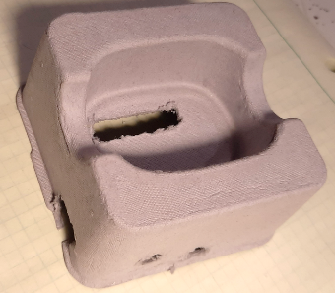
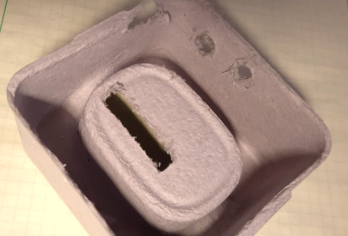
My original idea was to open up the temperature sensor and place the resistors on the board near the IC that does the actual temperature sensing. This would provide fast response time to Dead Air and require less than a hundred milliwatts of power from the audio amplifier. Although the temperature sensor can be opened to replace the battery it seemed very well sealed. I felt I would damage it should I try to saw it apart to get to the PC board. Instead I decided to enclose the sensor and amplifier in the same box the sensor was shipped in. I used an Exacto knife and a drill to put holes in places where the amplifier’s audio, power and volume controls were located. I cut a long slot directly under the temperature sensor for the resistors.

Slide 6
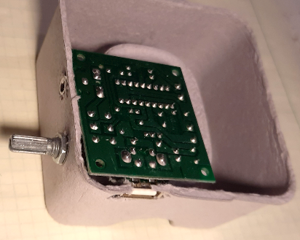
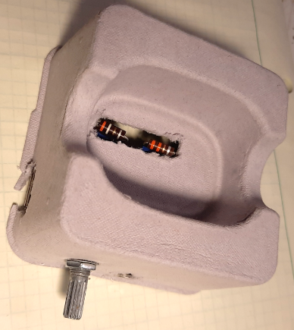
Here is the amplifier installed into the cardboard shell that holds the Aeotec temperature / leak sensor. The open hole for the resistors allows heat to reach the sensor more quickly.

Slide 7
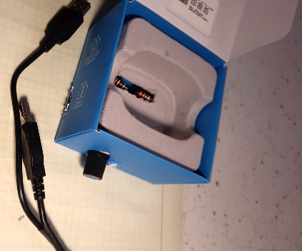
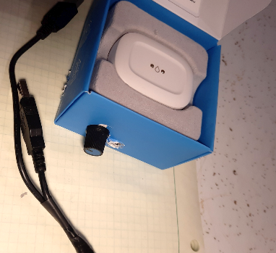
The cardboard shell is placed back into the box along with the Aeotec sensor. The mounting hardware for the volume control hold the amplifier in place with the knob pushed onto the volume control’s shaft.
It may take a little adjusting to make sure the USB port and audio jack are accessible for their respective cables.

Slide 8
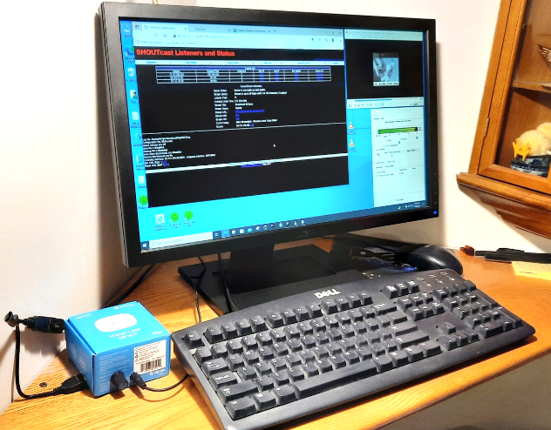
I placed the Dead Air monitor in a place where its temperature would be less affected by external heat sources such as the PC and baseboard heaters. I set the volume knob to about 2 o’clock to start and ended up leaving it there. The typical voltage across the 3.3Ω resistor peaks to around 0.5V which works out to just over 0.076W - well under the 0.25W rating.

Slide 9
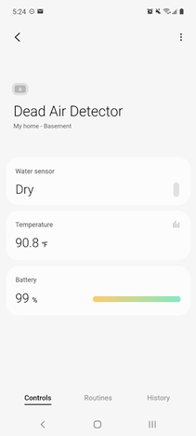
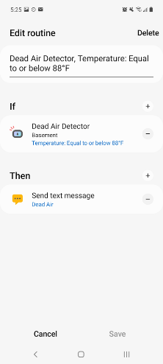
Register the Aeotec temperature/leak detector with your Samsung SmartThings hub using the app and the instructions that came with it. This can be as easy as scanning the 3D code on the sensor.
Set up a Routine to send a text alert when the temperature drops below the appropriate point.

Slide 10
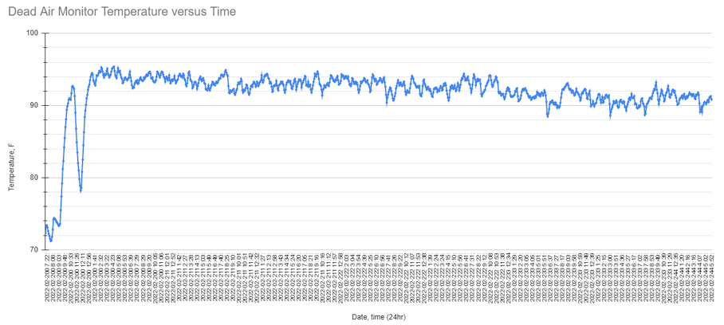
After several days of monitoring the lowest recorded temperature was just under 88.5°F which took place briefly one morning when it was cold outside (-13°F) and the ambient room temperature at around 68°F. I ended up setting a limit of 88°F to avoid false notifications.
Initial power-up
Audio unplugged for a few minutes to test notification, then reinserted. Notification took place approximately 12 minutes when limit was set at 85°F.

Slide 11
Results of test after briefly removing the signal going to the amplifier.
Audio was unplugged until notification was received after 5 minutes 52 seconds. Including the time it takes for the resistors to cool there will be several minutes delay due to the temperature sensor provides readings only every few minutes.

Slide 12
I created this Dead Air Detector for simplicity and speed since I needed a solution fast due to problems I was having with my audio processor software. The detector has the advantage of not requiring any software programming or difficult-to-build hardware and goes together quickly. The temperature / leak detector is also left unmodified should I decide to use it for another application someday. But I admit it doesn’t provide immediate notification in the case of Dead Air.
Increasing the power to the resistors and perhaps allowing sensor to be open to the air above it could speed up the notification process - but the delay in reporting Dead Air is mostly due to the temperature sensor’s reporting interval between every three to five minutes. This allows for good battery life but may not provide sufficiently fast notification for some streaming stations.
--- Dave, N0DL

